Slide 1
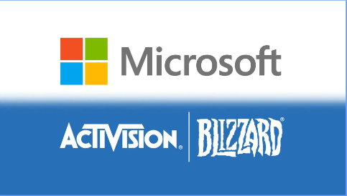
Deal advisory on
Microsoft's
acquisition of
Activision Blizzard

Slide 2


Overview
Industry Overview
Strategic Rationale
Deal Valuation
Transaction Structure
Risk and Market Reaction
Deal Strategy and Recommendation

Slide 3
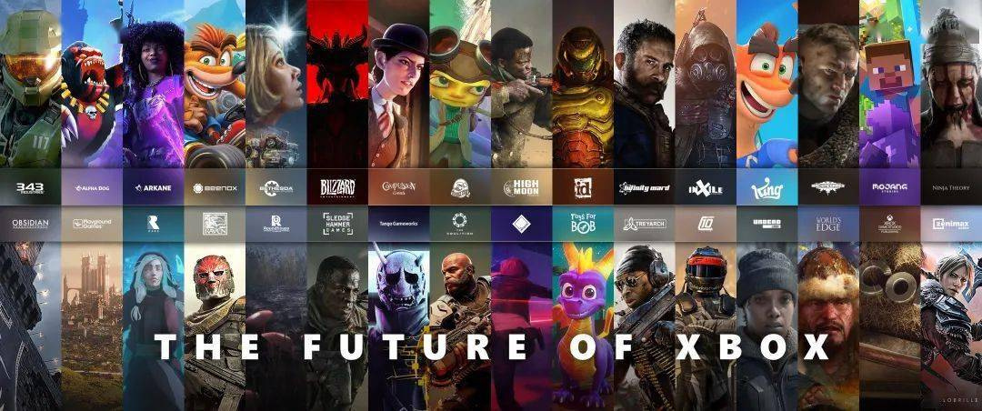
Industry Overview
Global gaming revenue reached $200 billion in 2022; projected to hit $256.97 billion by 2025.
Growth drivers: user expansion in Asia & North America, demand for high-quality gaming.
Emerging technologies: cloud gaming, AR, and VR.
Activision Blizzard’s strong IP, large user base, and market position.

Slide 4


Strategic Rationale
Motives:
Ownership Perspective
Management and Shareholder Perspective
Operational Perspective
Rationle:
Economic perspective
Strategic perspective
Finance and managerial perspectives
Behavioural finance
1. Microsoft's acquisition of Blizzard leverages industry growth and economies of scale to strengthen its market position.
2. the acquisition enhances its competitiveness in mobile gaming.
3. Learning from the success of LinkedIn to fine-tuning corporate governance and tax burden.
4. Be wary of overconfidence and possible risks connected with market passion.

Slide 5




Deal Valuation (DCF Method)
Standalone Value
Achievable Synergies
Control Premium
Assumptions :
1) Cash Flow: FCFF
2) Discount Rate: WACC1 (14.02%)
WACC2(12.79%)
3) Growth rate: g1 = 6%
g2= 2.9%
Valuation: $21,598 million
1) Revenue Enhancement
Valuation: $35,982 million
2) Cost Reduction
Valuation: $3,157 million
3) Asset Rationalization
Valuation: $32,748 million
Standard Range: 20%-30%
we determined at 21%
Supported by:
Strong historical financial performance
Leader position in the Industry
Conservative stance
Valuation: $26,133 million

Slide 6




Net Present Value & Intrinsic Value
NPV
Intrinsic Value
Price Comparison
Value = Standalone Value
+ Total Synergy Values
– Net Price
Valuation: $67,351 million
-Microsoft’s Offer Price = $95/share
-Fair Value Price = $86.43/share
-Current Market Price = $82.31/share
（As of 18th January 2022）
Fair Offer Price Range: $85-$90/share
(Based on Sensitivity Analysis )
Fair Value
= NPV of the Deal / Total Shares
Outstanding (779,234,888 shares)
FV = $86.43/share

Slide 7




Transaction Structure
Friendly Acquisition
Asset Purchase Method
Form of Consideration
Financing
"Structure designed for smooth integration of Activision Blizzard’s assets into Microsoft’s strategic framework."
"Flexibility in asset selection, excluding unwanted liabilities"
"Cash and stock payments for immediate returns and future growth potential"
"Combination of debt and cash reserves, leveraging favorable credit terms"

Slide 8

01
Transaction Risks
02
Regulation and scrutiny
Risk and market reaction
03
Shareholder and Market Reaction
04
Peer learning and how to manage

Slide 9



Deal Strategy
&
Recommendation
01
Microsoft should set up a special committee to develop a detailed plan and timeline.
Carry out acculturation training and team building activities.
Maintain transparent communication, and actively investigate and evaluate performance to alleviate employee anxiety.
Invest more in game development and innovation.
02
03
04

Slide 10
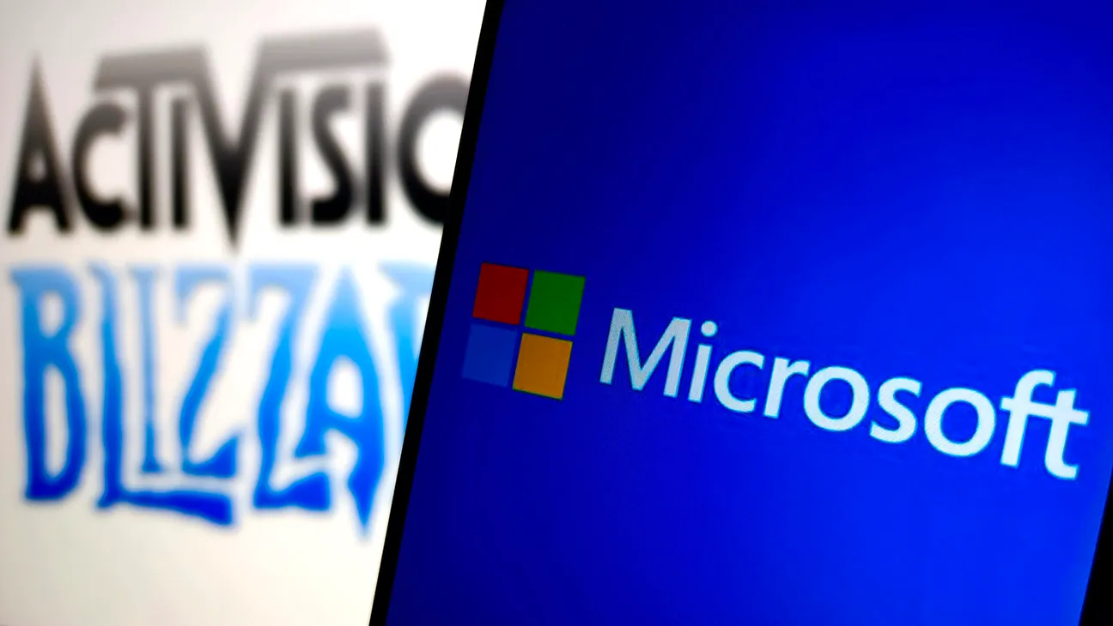
Thank you for Listening

